Slide 1
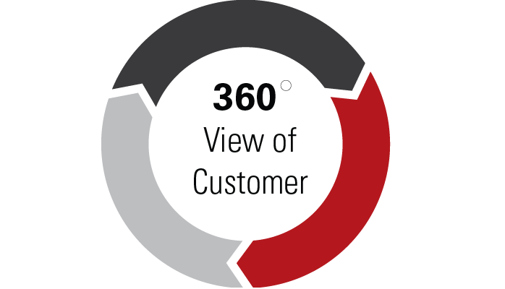
Customer 360
Most awaited project in Banking and Finance, Retail and Telecom

Slide 2
Agenda
Things you will learn
Customer 360 introduction
Key points
Architecture
Lab

Slide 3
Things you will learn
After completion of this project, you will learn the following:
Customer 360
Glance of Customer 360 on MongoDB

Slide 4
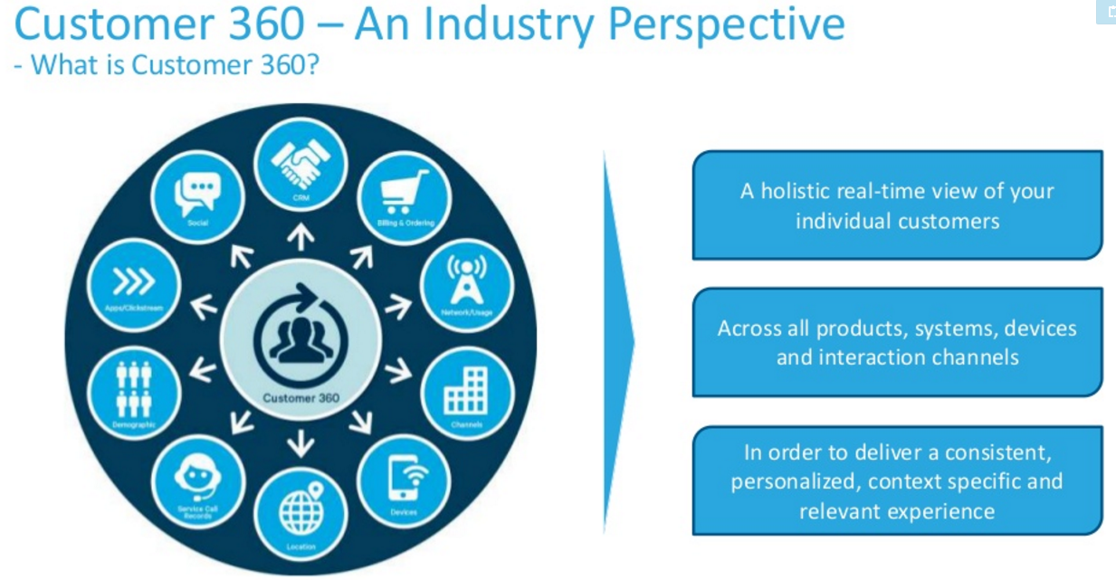
Reference: cloudera

Slide 5
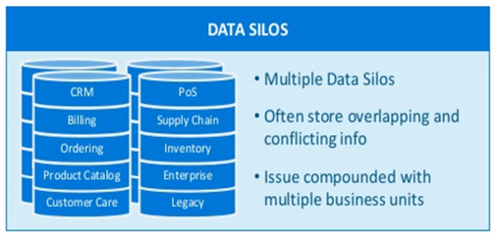
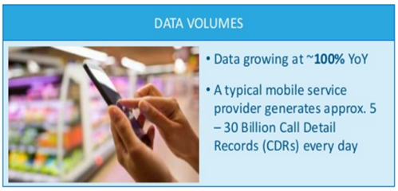
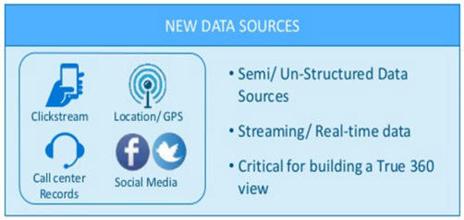
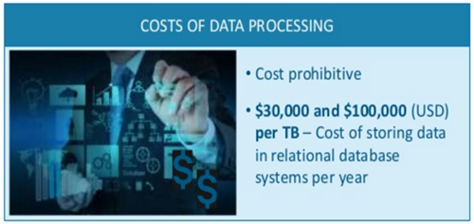
Key challenges in Driving a Customer 360
Reference: cloudera

Slide 6
Reference for Customer 360
http://www.slideshare.net/cloudera/using-big-data-to-drive-customer-360

Slide 7
What is customer 360
Customer 360 refers to summarized information related to customer, at every digital touch point, which describes the behavior of customer, and predicts what can happen with him in future.
It can be thought on mega table, which is holding information of all products a customer holds, summary of all customers transactions, demographic features, CRM information.

Slide 8
Why;Understand Your Customers
Improve the entire customer lifecycle with a customer 360-degree profile.
Any marketing team or any other team dealing with customers must leverage technology to:
collect and analyze customer data
execute successful omni-channel campaigns
understand the customer lifecycle
influence buyers in a congested market.

Slide 9
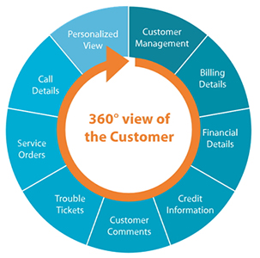
Possible data sources

Slide 10

Use case1; Customer Acquisition & Retention
How to acquire a new customer and how to retain existing customers is a big time challenge for any marketing team.
Now with customer 360, they know the DNA of customer, there by plan accordingly.
Especially in telecom sector, this is a big challenge.

Slide 11

Use case2: Next best offer
Whom to offer what is a big question?
Especially in retail sector, identifying loyal customers and offering them products based on previous transactions is a bigger challenge.
Having customer DNA will make it much simpler.

Slide 12

Use case3: Customer satisfaction
Email sent by a customer, needs an immediate response.
It’s important that organizations collect every interaction in order to identify leading indicators of unhappy customers, keep their existing customers, and improve net promoter scores.

Slide 13

Up sell and cross sell recommendations
Identifying similar customers is on the top priority for all the industries, as it can solve upsell, cross sell, product recommendation and many other problems.
To identify similar customers, one should have all possible information of customers, summarized and store digitally.
Customer 360 can do that.

Slide 14
Customer 360 on MongoDB
We will be working on dataset with following schema:
# address
# CityID
# StateID
# Street Number
# Zip Code
# demographics
# Age
# Job
# Salary
# products
# credit
# debit
# loan
# deposit
# ProductInfo
# credit --> type, limit, avgTrx, ontime payments, defaults, tags
# debit --> type, avgMonthEndBalance, noOfDebits, noOfCredits
# loan --> type, amount, ontime payments, defaults
# deposit--> type, amount, tenure

Slide 15
Import data into mongodb
To import data into mongodb, use mongoimport command.
Syntax:
mongoimport -d dbname -c collection --file pathOfFile
Get into cmd
Change directory to bin directory of MongoDB
Run the following command by providing the path of the file, db name
mongoimport -d mongoday2 -c Customer360 --file D:\edu\MongoDB\bankCustData.json
Check robomongo now

Slide 16
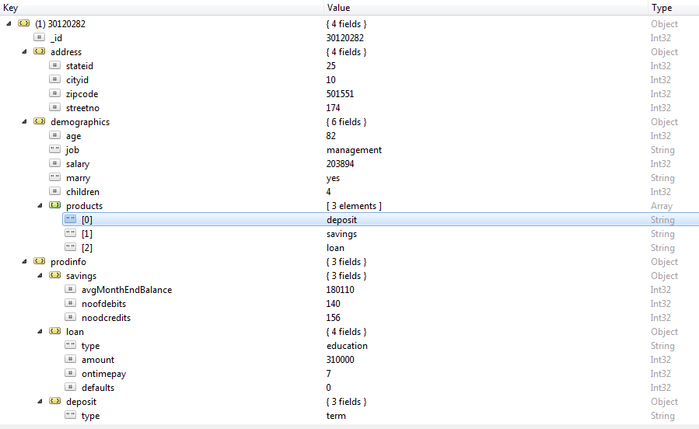
Data load check

Slide 17
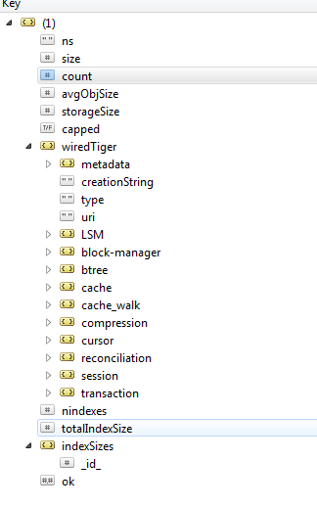
Collection stats
Stats function returns statistics about the collection.
Command:
db.Customer360.stats()
Refer to this link for full details:
https://docs.mongodb.com/manual/reference/method/db.collection.stats/#db.collection.stats

Slide 18
Now you can start Analyzing the data.

Slide 19
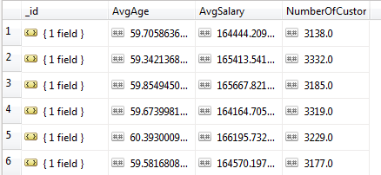
For each state, find out number of customers, average age, average salaried.
Repeat the same for each city and zip code.
Output:
Refer to file1

Slide 20
Find the following:
Number of unique states, cities, zipcodes and streetno.
Number of unique jobs.
Average salary for each job.
Number of married customers and unmarried customers for each job.
Refer to file2

Slide 21
Find the number of products each customer is holding.
Find the number of customers in different age bins. Bin width should be set to 10.
Find the number of customers holding each product.
Refer to file3

Slide 22
Find the following:
Number of customers who have 1, 2, 3 and 4 products.
Number of customers who have at least 2, 3 and 4 products.
Number of customers who have credit and loan account.
Number of customers who have credit and loan account but not savings.
Refer to file4

Slide 23
Find the following:
Number of customers for each credit card type.
Number of customers for each job type.
Number of customers for each credit tag.
Number of customers who have done credit defaults per each state, city.
Number of customers who have done loan defaults

